Slide 1
Kyiv
Kyiv team development plan – H2 2019
September 19, 2019

Slide 2
Content
1
2
Current state
KPIs tracker
Employee engagement
SWOT analysis
Road map
Structure
Strategy
Processes

Slide 3
Content
1
2
Current state
KPIs tracker
Employee engagement
SWOT analysis
Road map
Structure
Strategy
Processes

Slide 4






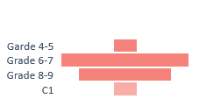
Kyiv team of 46 employees has managed to work on 26 projects with average billable utilization rate of 68% during H1 FY19-20; some of the main projects have been run by local managers
KPI tracker
Employee engagement
SWOT analysis
H1 FY19-20
Education
Gender
Age groups
By specialist group
By grade
Headcount
46
Non-CAP
Utilization
79%
Grade Pyramid
Specialists groups
By specialist group
By grade
Billable Utilization
68%
NPS by specialist
Consultant
Engineer
DS
Project types
Turnover
18%
NPS
-14
Projects #
26

Slide 5
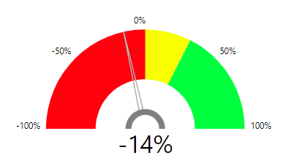
However, recent survey revealed that employee engagement is pretty low and there is a high level of uncertainty within the team regarding future opportunities and career growth
KPI tracker
Employee engagement
SWOT analysis
NPS
How likely are you to recommend Fractal (Kyiv) to your friends and family to work with us?
Definitely, no | Most probably, no | Not sure | Most probably, yes | Definitely, yes
total
?
Do you foresee yourself working here one year from now?
Do you believe you'll be able to reach your full potential here?
?
NPS
by group
+31%
If you were given the chance, would you reapply to your current job?
-14%
?
-50%

Slide 6
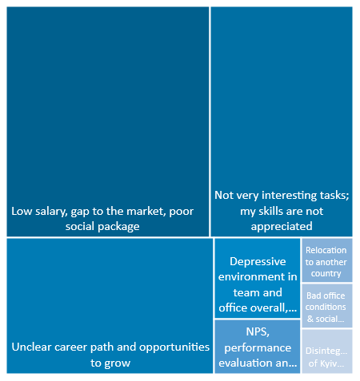
However, recent survey revealed that employee engagement is pretty low and there is a high level of uncertainty within the team regarding future opportunities and career growth
KPI tracker
Employee engagement
SWOT analysis
?
Hypothetically, if you were to quit tomorrow, what would your reason be?
I am satisfied with my current level of salary
I have clear understanding of my career or promotion path

Slide 7
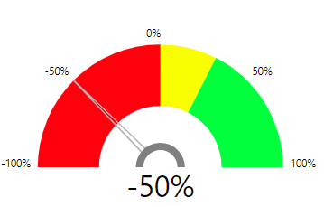
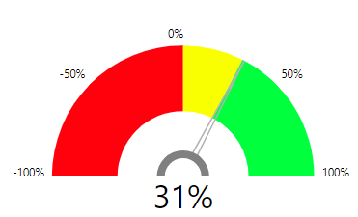
Current situation is primarily driven by the extremely low engagement of consultants into Fractal projects & communication flow…
KPI tracker
Employee engagement
SWOT analysis
NPS
?
Do you foresee yourself working here one year from now?
?
Do you believe you'll be able to reach your full potential here?
?
If you were given the chance, would you reapply to your current job?
Consultants
Data Scientists
Data Engineers
Definitely, no | Most probably, no | Not sure | Most probably, yes | Definitely, yes

Slide 8
… while being the most utilized and demanded they do not have clear vision on their professional growth
KPI tracker
Employee engagement
SWOT analysis
Consultants
Data Scientists

Slide 9
Most of the current opportunities and competitive advantages are related to the ability to efficiently use existing resources and grow new capabilities
KPI tracker
Employee engagement
SWOT analysis
S
W
Strength
Weaknesses
Close to Europe;
Market with strong DS and DE candidates;
Combination of data science and software engineering experience;
Strong forecasting experience;
Strong design thinking and business acumen.
Very limited client facing and client engagement experience;
Limited experience with Fractal products;
Low employee satisfaction.
Opportunities
Threats
Native speakers of Russian language (all post-soviet countries speak);
Leverage knowledge of other European languages for NLP projects.
Increased employee resignation rate;
Low people billable utilization;
Lose momentum on Ukrainian market.
O
T

Slide 10
Content
1
2
Current state
KPIs tracker
Employee engagement
SWOT analysis
Road map
Structure
Strategy
Processes

Slide 11
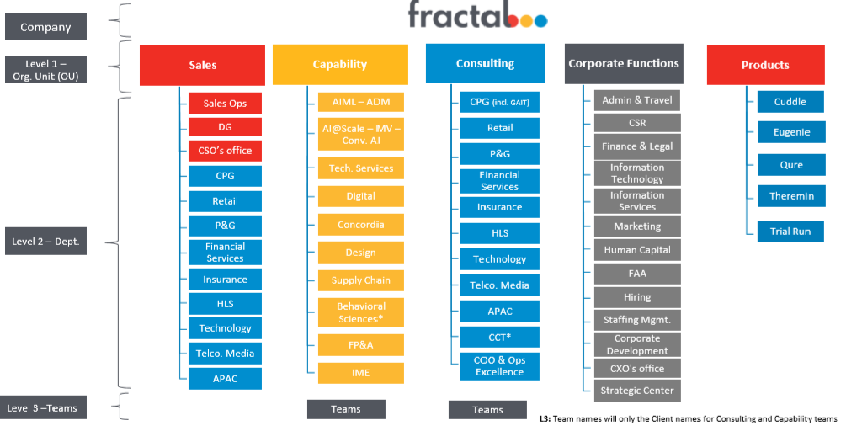
New Fractal Organizational Structure with Kyiv office within Consulting OU and CPG department
Structure
Strategy
Processes

Slide 12
Current Kyiv organizational structure complicates the management and tracking of the team performance; it does not allow to effectively develop capabilities, grow and expand employee skills
Structure
Strategy
Processes
Tatyana Popova
Dmytro Maliarenko
Demand Forecasting
Demand Forecasting
Forecasting,
Software Development
Forecasting, P&P (Modelling team)
Consultants - 6
Data Scientists - 3
Capability
Demand Forecasting
Demand Forecasting
Forecasting, P&P (Consulting team)
AI Forecasting
Alina Ignatiuk
Andrey Antonenko
Current tracks
Data Scientists - 10
Consultants - 12
Direct Selling
CPG
Engineers - 2
Engineers - 4
Data Scientists - 1
Managers - 1
Domain
Pharma
Industry
Managers (QA) - 1

Slide 13
Implementation of a new Kyiv organizational structure will enable efficient management of specialists’ skills, development of existing and new capabilities and enhance overall performance
Structure
Strategy
Processes
Alina Ignatiuk
Andrey Antonenko
Andrey Antonenko (interim)
Daria Miseng
Delivery Management
Data Science
(Traditional)
Data Engineering
Decision Science/ Delivery Management
Data Science
(Traditional)
Data Engineering
HC
Daria Miseng
Travel
Consultants- 6
Data Scientists - 4
Consultants - 2
Data Scientists - 2
Data Engineers - 1
Tatyana Popova
Dmytro Maliarenko
Alina Ignatiuk (interim)
Nataliia Biesova
Data Science (AI/ML)
Finance
BI Development/ Visualization
Data Science (AI/ML)
Software Engineering
Design/ BI Development/ Visualization
Software Engineering
Viktoriia Datsenko
Admin
Consultants - 8
Data Scientist - 8
Software engineer - 7
…
Andrey Antonenko
IT local
Data Analyst (temporary position) - 3

Slide 14
Kyiv office development strategy should leverage existing and develop new skills, expand domain knowledge expertise and project types, bring existing analytical solutions to the market
Structure
Strategy
Processes
SKILLS
DOMAIN KNOWLEDGE
PROJECTS
ANALYTICAL SOLUTIONS

Slide 15
Close cooperation and involvement of Kyiv team in different Fractal projects across the accounts will allow to develop new skills
Structure
Strategy
Processes
SKILLS
Delivery Managers
BI Development/ Visualization
Data Scientists
Engineering
Tools: MS Office (advanced), Tableau/ Power BI (low to mid), SQL/R/Python (low to mid), SPSS (low to mid), Nielsen Answers/Adviser mid), Wordpress (mid), Agile (mid), AI/ML (low to mid)
Expertise: Problem-solving and insights generation, business analysis, project management, client communication, design
Tools: MS Office (advanced), Tableau/ Power BI (advanced), SQL/R/Python (low to mid), UI/UX, Nielsen Answers/Adviser, AI/ML (low to mid)
Expertise: Problem-solving and insights generation, business analysis, prototyping dashboards, design
Tools: SQL/R/Python/ C/C++, Java; NumPy, SciPy, Pandas, Scikit-learn, statsmodels, matplotlib, seaborn, plotly; PyMC, SPSS, Tensorflow, Keras
Expertise: Building analytical, statistical, machine learning and probabilistic models
Tools: Python, C/C++, C#, VBA, SQL, Django, R, Angular 2/4, JavaScript, CSS3, Node JS, HTML5, STL, OOP, Design Patterns, UML, Type Script, PHP, HTLM, Java
Expertise: Analytical and ML tools, analytical software development & deployment (front-end and back-end, incl. testing and PM), software architecture design
EXISTING
To nurture: Client engagement, AI/ML, new domain knowledges, cloud technologies
To nurture: QlikView/Spotfire, UA/UX, AI/ML, domain knowledge
To nurture: state of the art ML/DL algorithms; Cloud Computing, Distributed Computing, NLP, CV
To nurture: Cloud technologies, Data engineering
NEW

Slide 16
There is also an opportunity to expand domain knowledge of current employees through close cooperation with Fractal domain experts and leverage their skills across different client functions and industries
Structure
Strategy
Processes
DOMAIN KNOWLEDGE
CPG
HEALTH & PHARMA
INDUSTRY
DIRECT SELLING
Colgate, Unilever, RB, P&G, J&J, Mondelez, SC Johnson, Danone, Hain Celestial, Mead Johnson, Mars, Kellogg, Hormel,
Smucker’s, Del Monte, Purina, PepsiCo, Coca Cola, Red Bull, Walmart, Johnsonville, etc.
Chattem, Bayer, Merck
Flack Steel,
Cox Automotive,
Whirlpool, Viega, Intuit
AVON
EXISTING
SUPPLY CHAIN
FP&A
SOCIAL MEDIA
E-COMMERCE
NEW

Slide 17
Kyiv team has a broad experience in different types of projects with full in-house capabilities for forecasting, P&P projects and analytical solutions software engineering and development
Structure
Strategy
Processes
PROJECTS
EXISTING
NEW
Forecasting
SRM
Analytical software development
POWER BI DASHBOARDS
Strategic
Business
Operational
P&P
Level:
category/market;
Drivers-based & ML/AI:
Possible Outputs: forecasts, due-to driver decomposition, simulators & “what-if scenarios”;
Possible Delivery: forecasts, code, in-house customized tools development
Level: SKU/account;
Drivers-based: controllable (price, distribution, trade activities, etc.) and uncontrollable (seasonality, competitor activities, etc.);
Possible Outputs: optimal discount depth, frequency, offer types, unprofitable offers, etc.;
Possible Delivery: insights & recommendations, code/model, in-house customized simulation tools development
Complete cycle of In-house development of analytical software solutions:
MVP,
solution architecture designing,
back-end, front-end, DB and user management modules,
PM, costs estimation, business analysts;
deployment, operationalization & support.
Team: PM, back-end and front-end engineers, data engineers, tester, BAs
brand/channel;
SKU/channel;
CLOUD DATA ENGINEERING
macro drivers & category drivers (marketing and trade spend, pricing action, innovation, distribution);
macro drivers (economy, demographics, consumer, etc.) & category drivers (category development, distribution, pricing, marketing support);
controllable (price, distribution, trade, discount, offer types, etc.) and uncontrollable (economy, weather, seasonality, etc.);
OPTIMIZATION TASKS
AutoML

Slide 18
Kyiv software engineering, data engineering and DS teams have already more than 5 years of experience of in-house analytical solutions development from initial stage to deployment, operationalization and support
Structure
Strategy
Processes
ANALYTICAL SOLUTIONS
DFM
IAP Forecasting
IAP Marketing Mix
AI/ML forecasting
Description:
Multi-channel, multi-offer SKU level forecasting decision support system
Business user:
Demand planners
Client: Avon
Status: Ongoing support
Description:
1) SKU level seasonal simulator; 2) Category/segment level forecasting tool
Business user:
1) Demand planners;
2) Global strategic planning
Client: Mars, Mondelez
Status: Draft working version available
Description: MINE.
Marketing Mix strategy tool
Business user:
Pricing team
Client: Fractal. IME
Status: Ongoing support & enhancements
Description:
Automated machine learning forecasting platform (demand/sales/revenue)
Business user:
Data Scientists;
Supply chain planning division
Client: Fractal CPG: Embed AI - AI Forecasting
Status: Development stage
EXISTING
NEW CLIENTS
NEW

Slide 19
Kyiv office development roadmap at this moment includes a set of processes and practices that should be launched and supported going further
Structure
Strategy
Processes
Aug’19
Sept’19
Oct’19
Dec’19
Jan’20
Feb’20
1. Current state analysis: - Resources;
- Utilization;
- Productivity.
Running first iteration
Revise & update
2. Operational & Strategic planning:
- Strategic;
- Operational.
Execute & update
Developing initial plan
3. External communication (with Bhaskar’s support):
Account leads & sales team (Mars);
Domain experts (Supply chain, Financial services);
Develop and execute action plan
Establishing primary contact
4. Internal communication (Kyiv team):
Share the vision and plan;
Involve team into discussion;
Work closely inside specialist groups.
Execute & update
Developing communication plan
5. Increase employee engagement:
Individual career growth approach;
Clear salary & promotion policy;
Decrease market gap.
Execute & update
Developing initial plan

Slide 20
Appendix

Slide 21
In long-term perspective organizational structure of Kyiv team will further evolve to cover project specialist demand
New organizational structure
Specialists role approach** (HRMS)
Dedicated teams approach (project role)
Alina Ignatiuk
Dmytro Maliarenko
Andrey Antonenko
Power BI Dashboards
Forecasting Tools
Capability: turn-key projects of Power BI dashboards development.
Dedicated team: 2+ Specialists: VC, DE (for big projects DM)
Capability: turn-key projects of forecasting tools development.
Dedicated team: 3+ Specialists: DE(s), ENG(s), DS(s), DM.
Delivery Management
Data Science (AI/ML)
Data Engineering
Tatyana Popova
Alina Ignatiuk (interim)
Visualization
Software Engineering
Drivers Analysis / Forecast
Strategic Planning
Capability: turn-key projects of KBD identification and future assessment.
Dedicated team: 2+ Specialists: VC, DS (for big projects DM)
Capability: turn-key projects of Strategic roadmap development.
Dedicated team: 3+ Specialists: DE, VC(s), DM
Daria Miseng
Viktoriia Datsenko
Nataliia Biesova
HC
Admin
Finance
Individual professional approach іs a possible option
…
Daria Miseng
IT local
Travel
**long term solution (9-12 months)

Slide 22
What is a dedicated team?
New organizational structure
Dedicated Team (DT) is a business model that refers to an agreement between the client (Fractal) and service provider (Kyiv office), when the latter provides group of professionals to the client on a long-term basis. These specialists are chosen according to the demands of the client for their experience and skillsets.
Characteristics of DT:
Can be managed by Fractal PM or/and Kyiv DM.
Dedicated team model pricing system: there are monthly payments that depend on the team size.
Best suitable when the scope of the project could not be strictly defined, and requirements can be changed during the development process. It perfectly suits a dynamic project with changing requirements and tasks, but defined end goal.
The main purpose of this model is to hire a team that will compensate for the lack of necessary expertise and will work seamlessly.
Advantages of the Dedicated Team model:
Predictable and defined budget
Full control over the management of the team
Dedicated team members have a deep understanding of the client’s project and business goals
Continuous communication with the team through everyday communication
The team is stable and is fully dedicated to the client/capability/project types
Disadvantages of the Dedicated Team model:
Inefficient for short-term projects (several weeks)
Crewing takes time
Team management also takes time
The value proposition of the team should be clearly identified and communicated to the client

Slide 23
Dedicated team approach on the projects allows to insure high quality and predictable results as well as positive working experience
New organizational structure
Example of dedicated team (based on Forecasting Tools capability)
Delivery manager
Fractal PM
Fractal Sales Person
Data Scientist (AIML
or / and
Traditional)
BI Analyst
Data Engineer
Engineer
Client Manager
Client Sponsor

